Slide 1





Breaking Bad: A Dataset for Geometric Fracture and Reassembly
Neural Information Processing Systems (NeurIPS) Track on Datasets and Benchmarks, 2022
Silvia Sellán
Yun-Chun Chen
Ziyi Wu
Animesh Garg
Alec Jacobson
Notes:
We present Breaking Bad, a dataset for geometric fracture and reassembly. This is joint work with Silvia, Yun-Chun, Ziyi, Animesh and Alec.

Slide 2
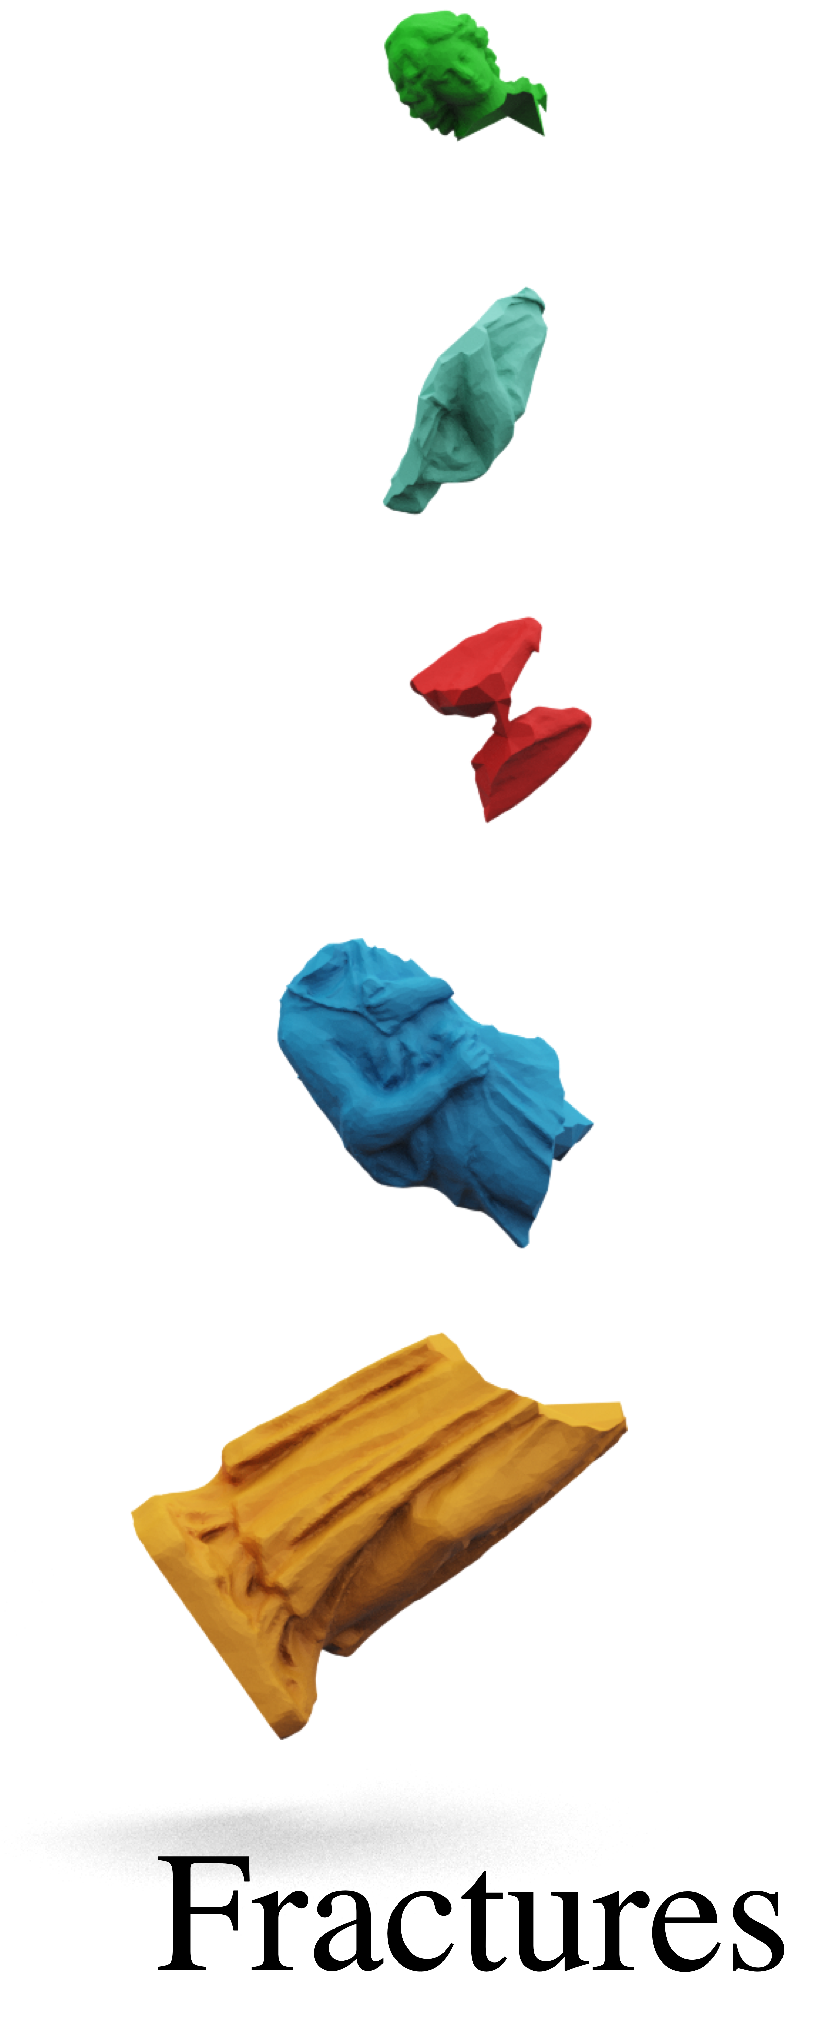
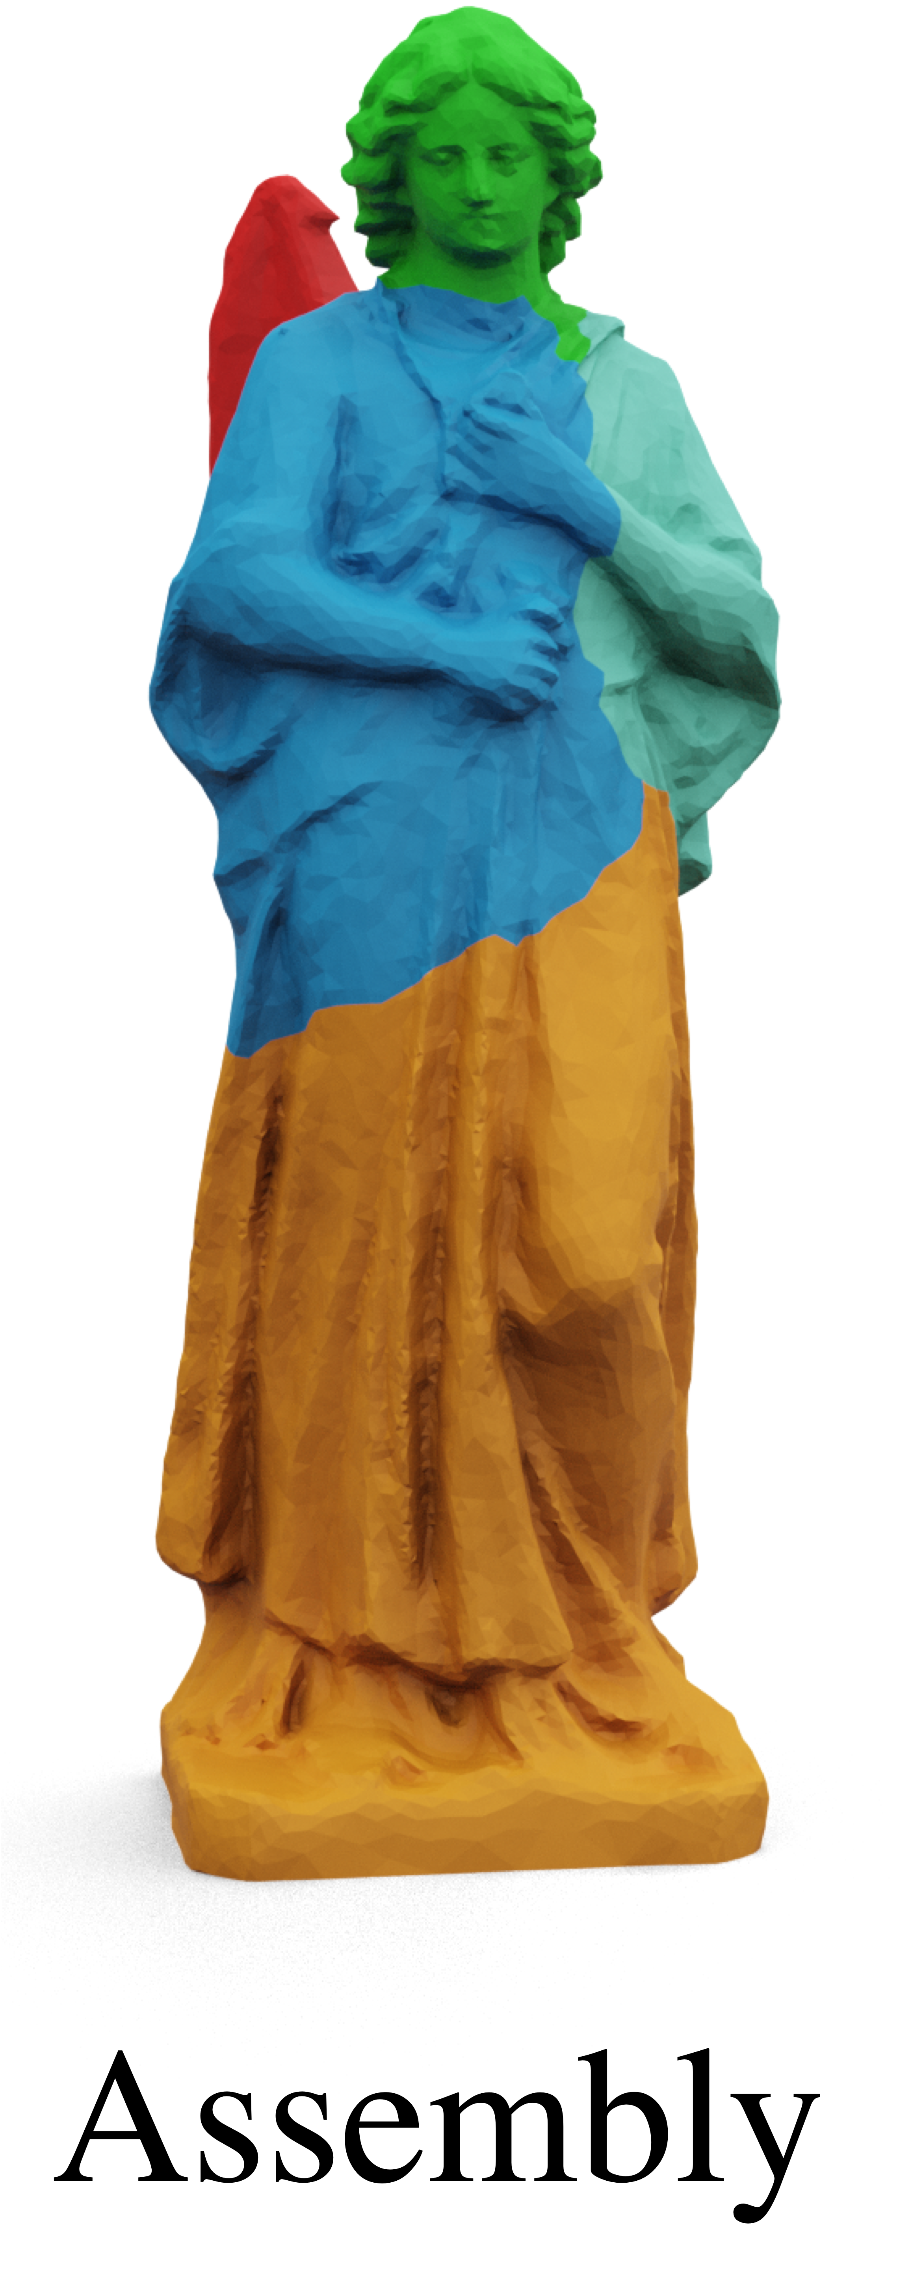
Task: Fracture reassembly
Notes:
Fracture reassembly aims to compose the fragments of a fractured object back into its original shape.

Slide 3
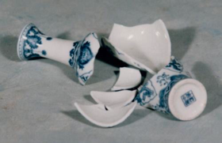
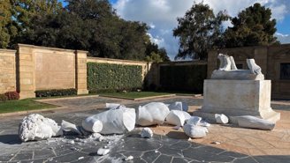
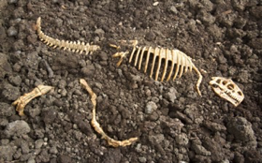
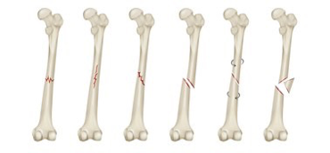
Examples of fractures
Notes:
With applications in artifact preservation, digital heritage archiving, computer vision, robotics and geometry processing, fracture reassembly is a practical yet challenging task that receives attention from multiple communities.

Slide 4
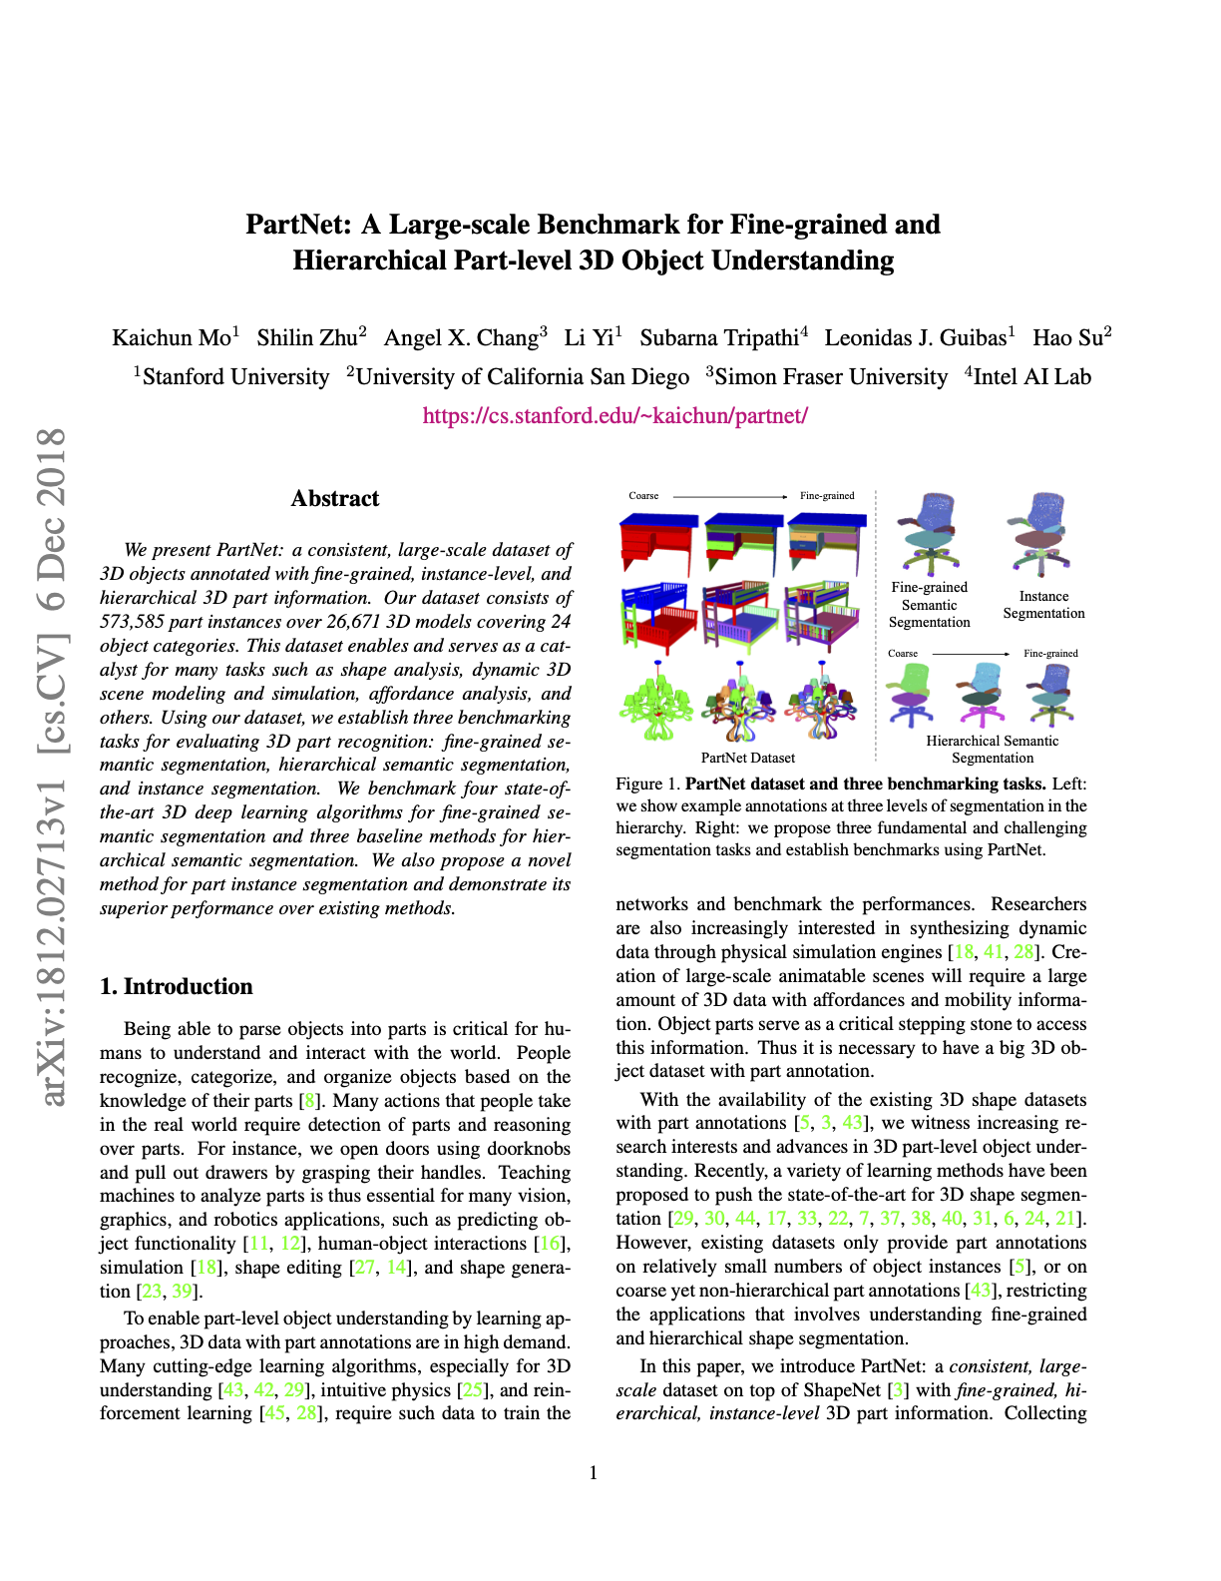
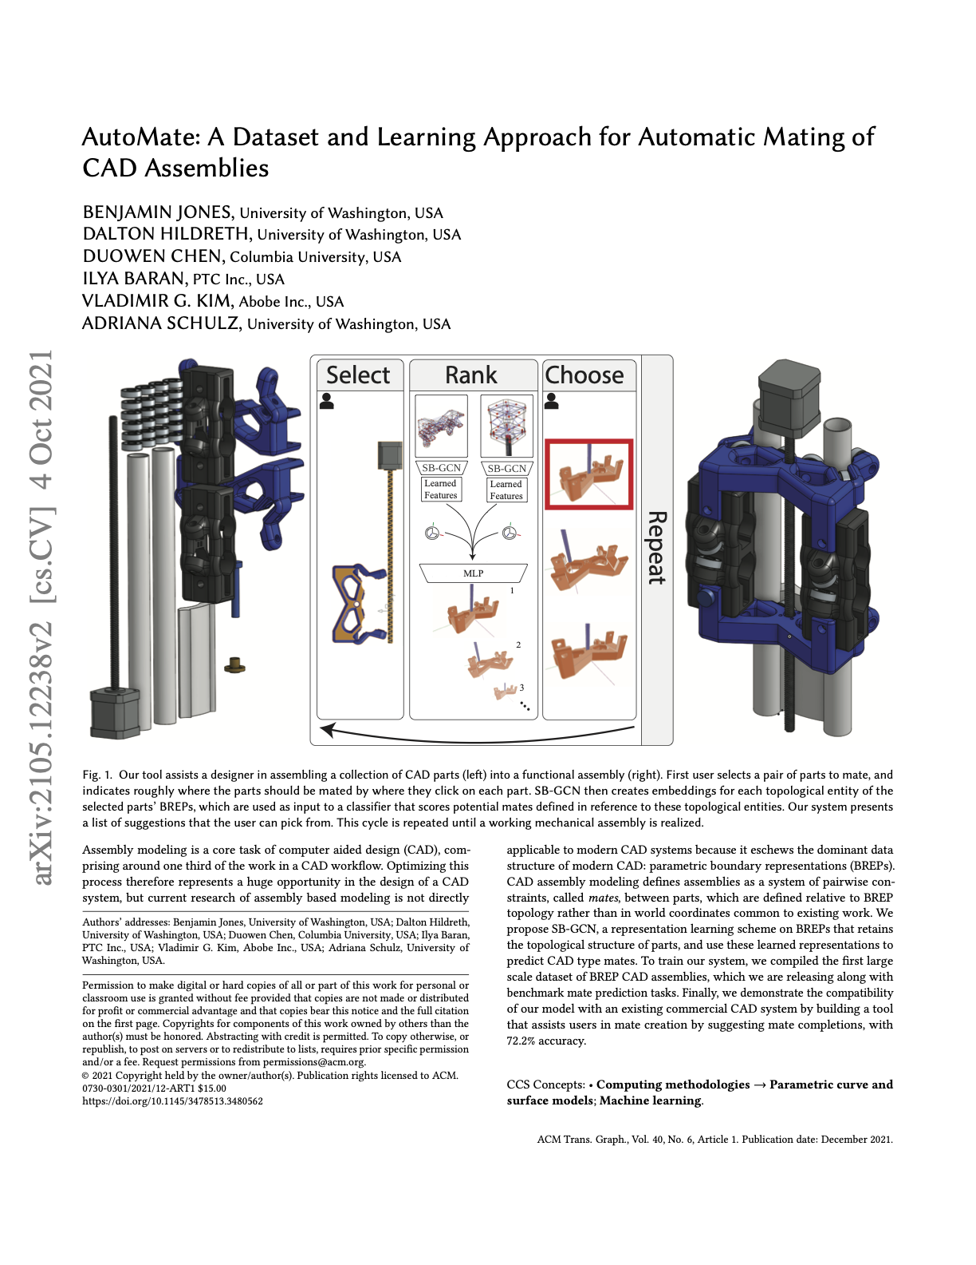
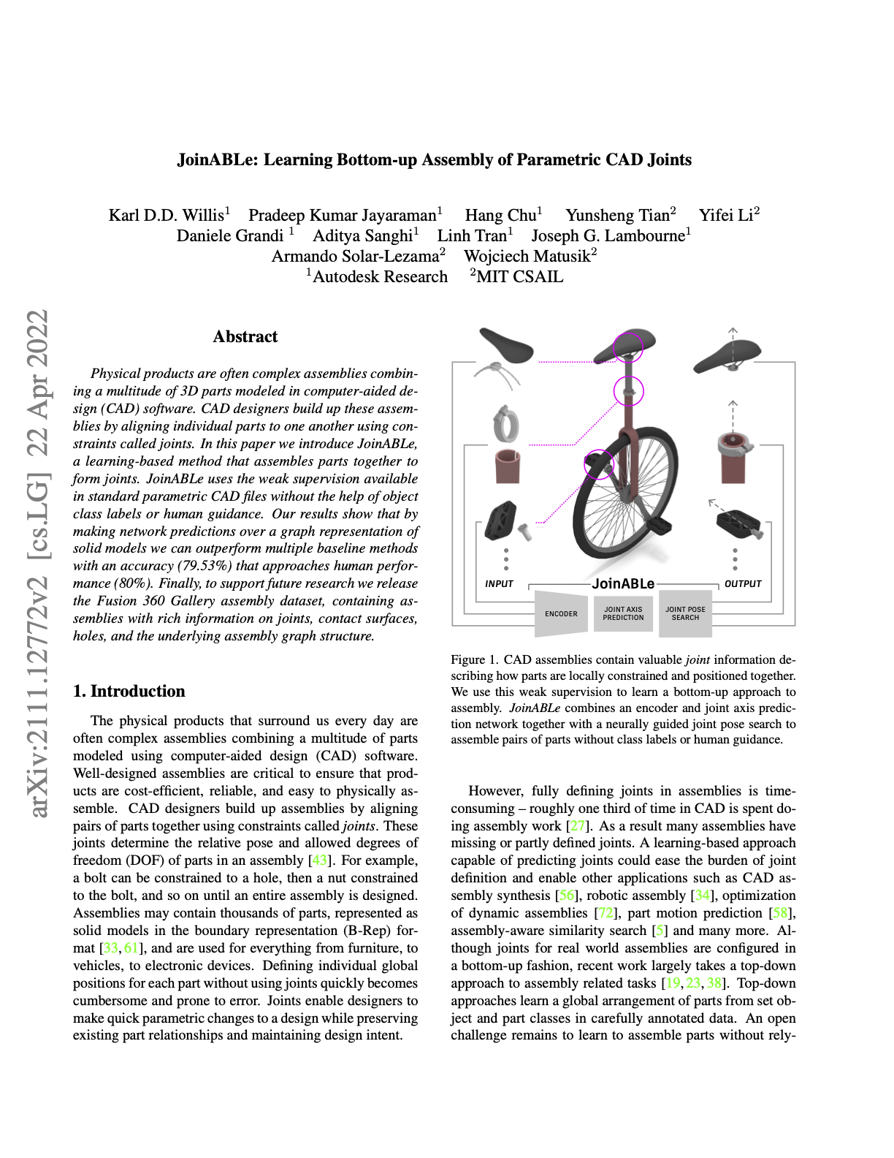
Existing assembly datasets
PartNet
AutoMate
JoinABLe
Notes:
Machine learning approaches have shown progress on the fracture reassembly task, but require large-scale datasets of fractured objects. Existing assembly datasets like PartNet, AutoMate and JoinABLe are constructed based on human or automated semantic segmentation.

Slide 5
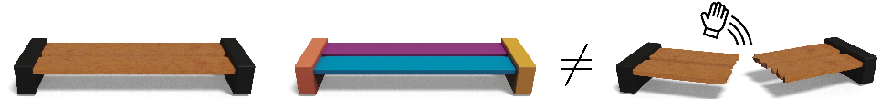
Semantic vs. Geometric
Object
Semantic
Geometric
Notes:
The objects in these datasets are decomposed in a semantically consistent way. However, objects that break naturally due to external forces generally do not break into fragments that are semantically well defined. Therefore, existing part assembly datasets are not suitable for studying fracture reassembly.

Slide 6
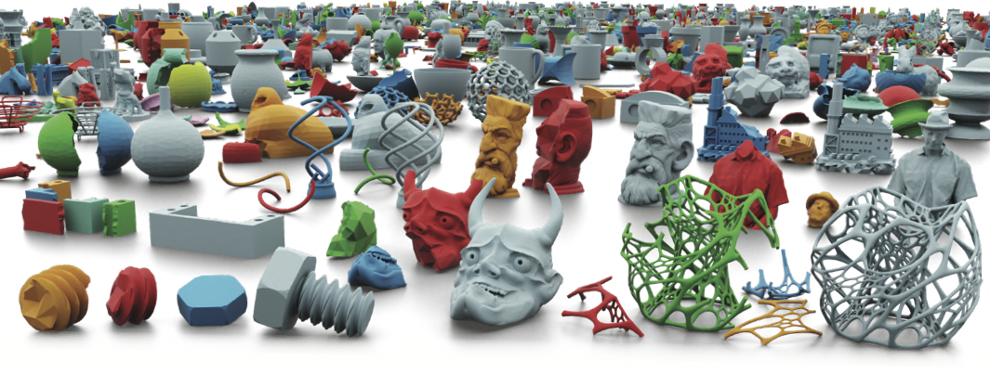
Breaking Bad: A dataset for fracture reassembly
Notes:
In this paper, we introduce Breaking Bad, a large-scale fractured object dataset.

Slide 7
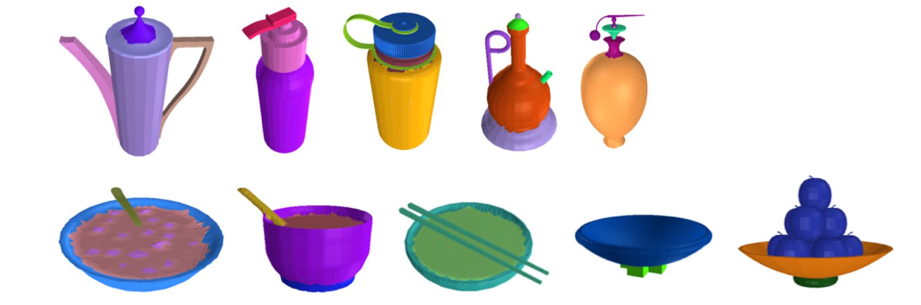
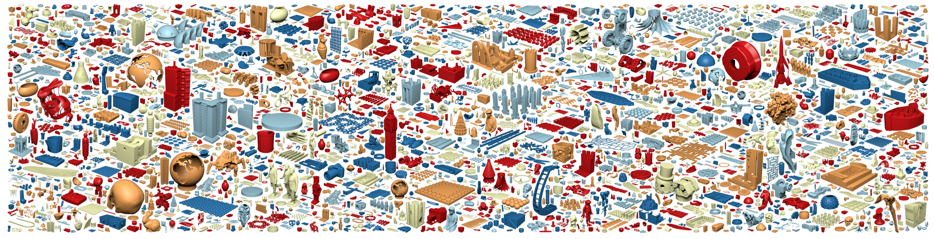
Dataset generation
Select 10k base shapes from PartNet and Thingi10k

Slide 8
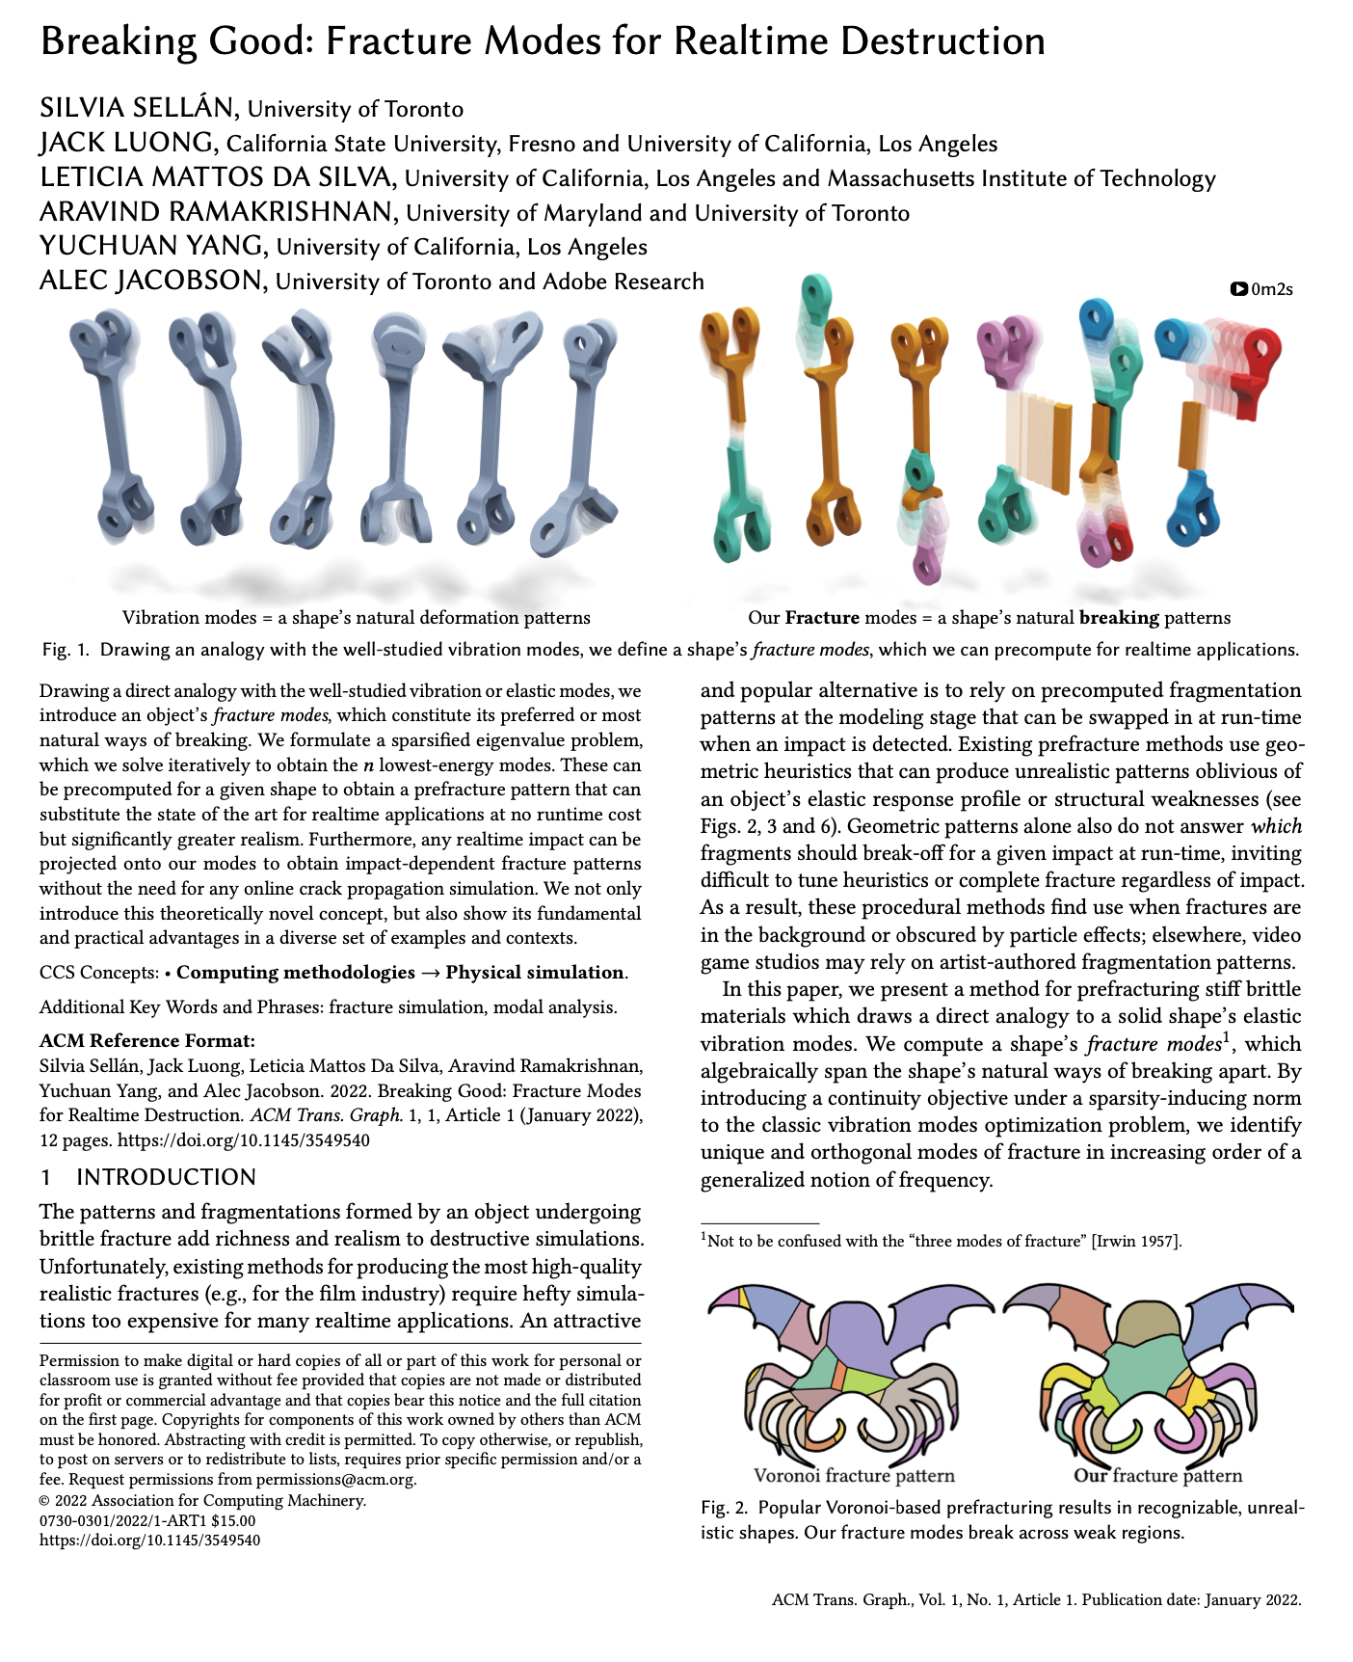
Dataset generation
Select 10k base shapes from PartNet and Thingi10k
Sellán, Luong, Mattos Da Silva, Ramakrishnan, Yang, Jacobson
SIGGRAPH Asia 2022
Notes:
Test test

Slide 9
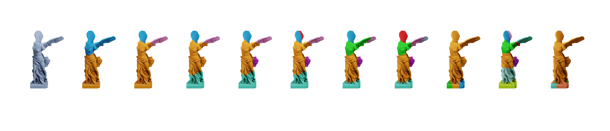
Dataset generation
Select 10k base shapes from PartNet and Thingi10k

Slide 10
Dataset generation
Select 10k base shapes from PartNet and Thingi10k
Compute 20 first fracture modes for each base shape

Slide 11
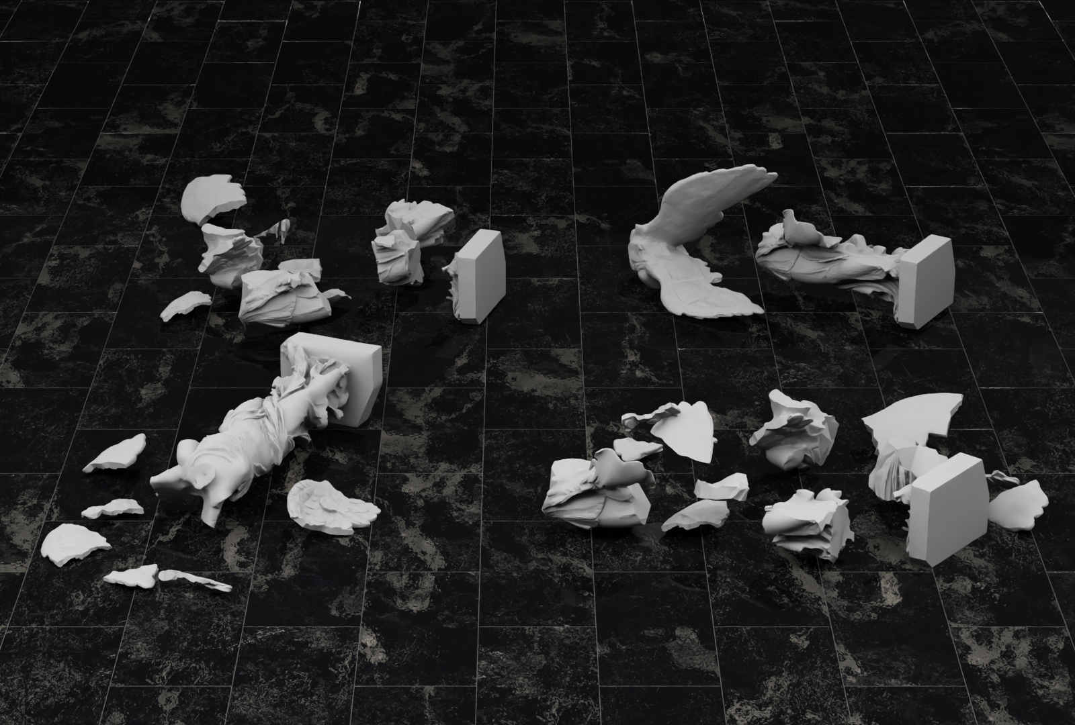
Dataset generation
Select 10k base shapes from PartNet and Thingi10k
Compute 20 first fracture modes for each base shape
Simulate random impacts to produce 80 different fractures

Slide 12
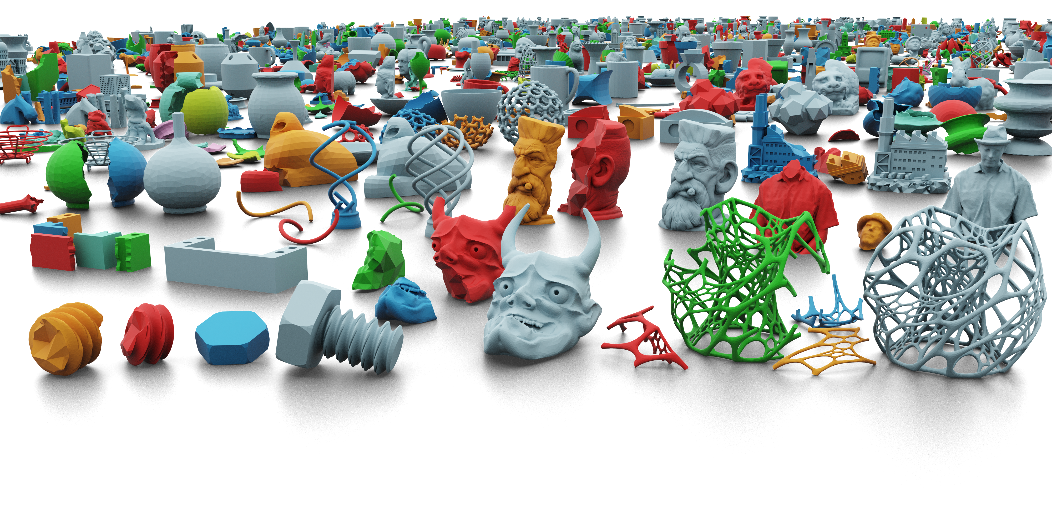
Our dataset: 1M fractures

Slide 13
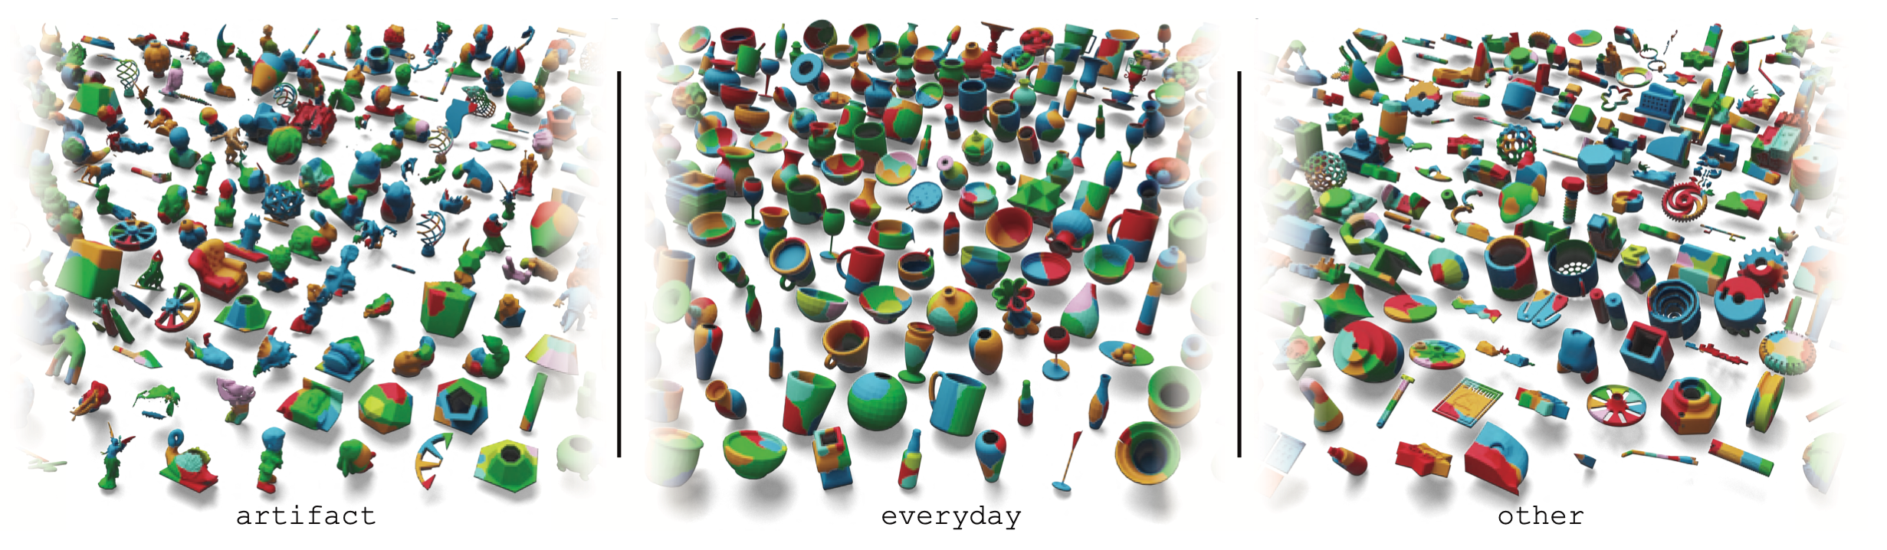
Our dataset: 1M fractures

Slide 14
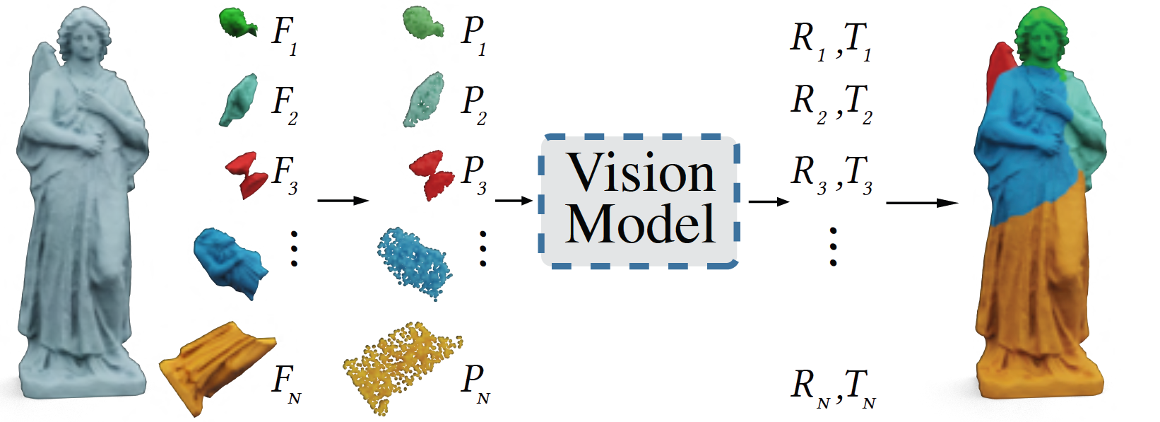
Benchmark
Select 3 SOTA semantic assembly models
Object
Pieces
Points
Poses
Assembly
Notes:
With our dataset, we benchmark 3 state-of-the-art semantic assembly methods on it. In general, these models take in point clouds sampled from each part, use PointNet to extract features, and perform inter-part reasoning, followed by pose regression

Slide 15
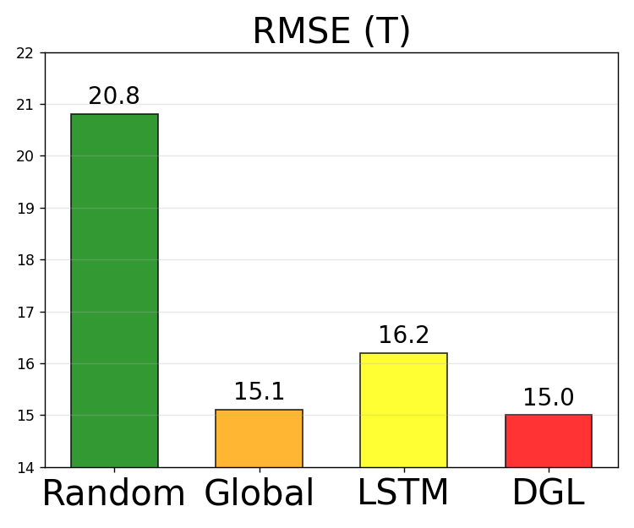
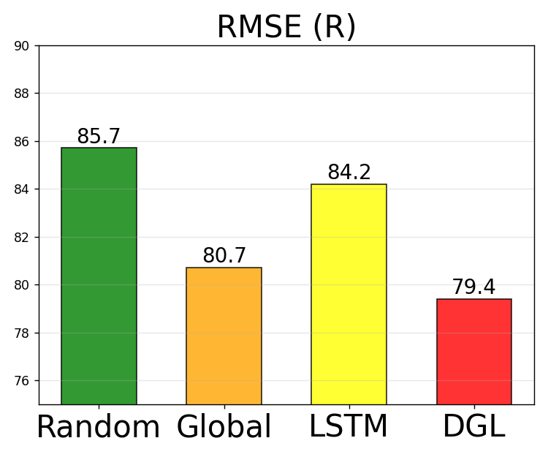
Benchmark
Select 3 SOTA semantic assembly models
Results on everyday subset
Notes:
Here we show the benchmark results on the everyday subset. We plot the rooted mean squared error of the predicted rotation and translation, lower is better. Overall, DGL performs the best due to its powerful GNN-based reasoning module. And compared to random baseline, these models achieve clear improvements in translation, but still perform very bad in rotation

Slide 16
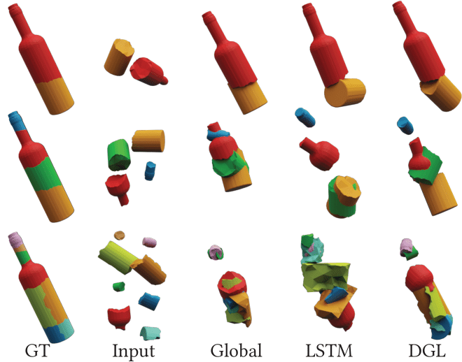
Benchmark
Select 3 SOTA semantic assembly models
Results on everyday subset
Notes:
Qualitatively, to assemble this bottle with different number of pieces, Global and LSTM completely fail when the number is large. DGL is able to place each part back to its original position, but fail to predict the correct orientation

Slide 17
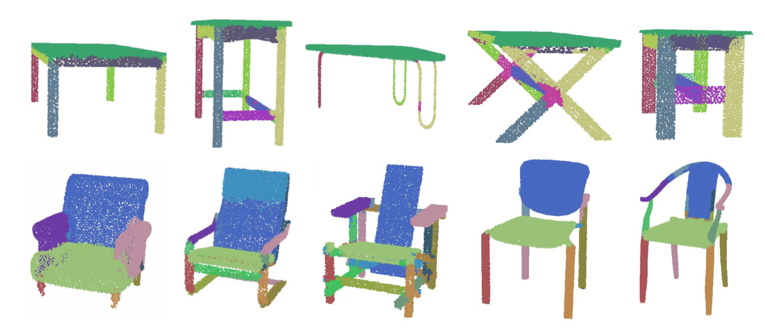
Analysis
Semantic assembly models leverage part priors – global feature
Notes:
Our experiments prove that SOTA models suffer from drastic performance drop in geometric assembly. This is because in semantic assembly, each part has a clear meaning, such as the table leg and the chair arm. To leverage such part priors, existing methods apply PointNet to extract global features from each part

Slide 18
Analysis
Semantic assembly models leverage part priors – global feature
Geometric assembly relies on local surface matching – local feature
Notes:
However, in geometric assembly, parts are not semantically well-defined. So models need to rely on local features for surface matching, which cannot be achieved by the PointNet global feature in existing methods

Slide 19
Future Work
New model architectures
Notes:
In summary, we propose Breaking Bad dataset to study the problem of geometric assembly. The poor benchmark results call for new models designed for this task

Slide 20
Future Work
New model architectures
New tasks
Robotics
Notes:
Our dataset can also be used in several new tasks, such as sequential decision making in robotics

Slide 21
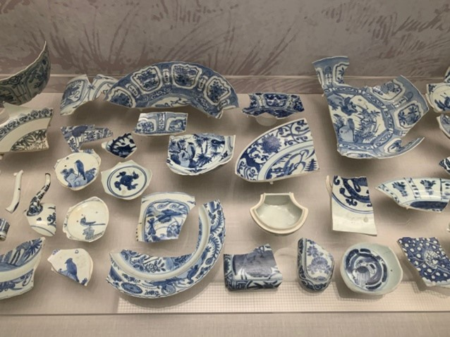
Future Work
New model architectures
New tasks
Robotics
Archaeology
Notes:
assembly with missing or distorted parts in archaeology

Slide 22
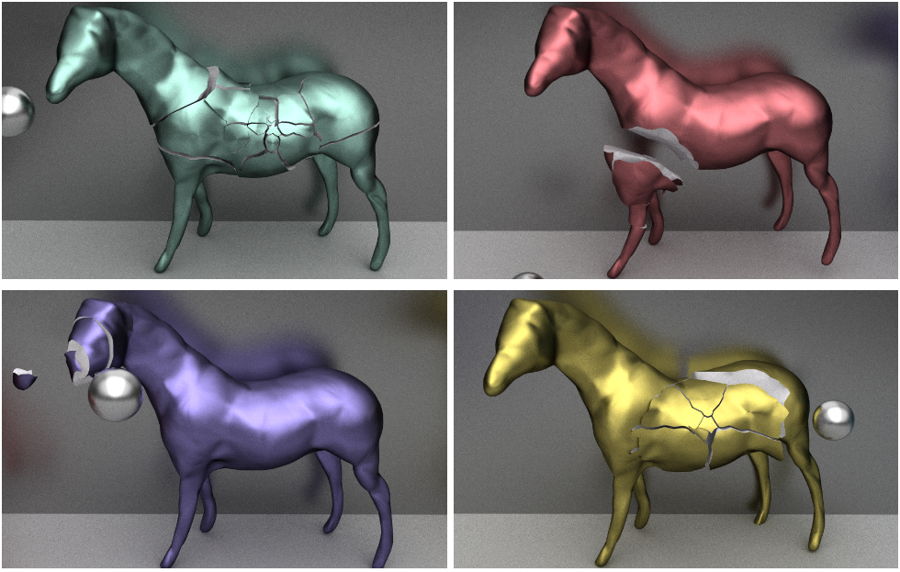
Future Work
New model architectures
New tasks
Robotics
Archaeology
Computer graphics
...
Notes:
and real-time example-based fracture algorithms in computer graphics. Overall, we believe our work opens up new possibilities to many promising directions

Slide 23
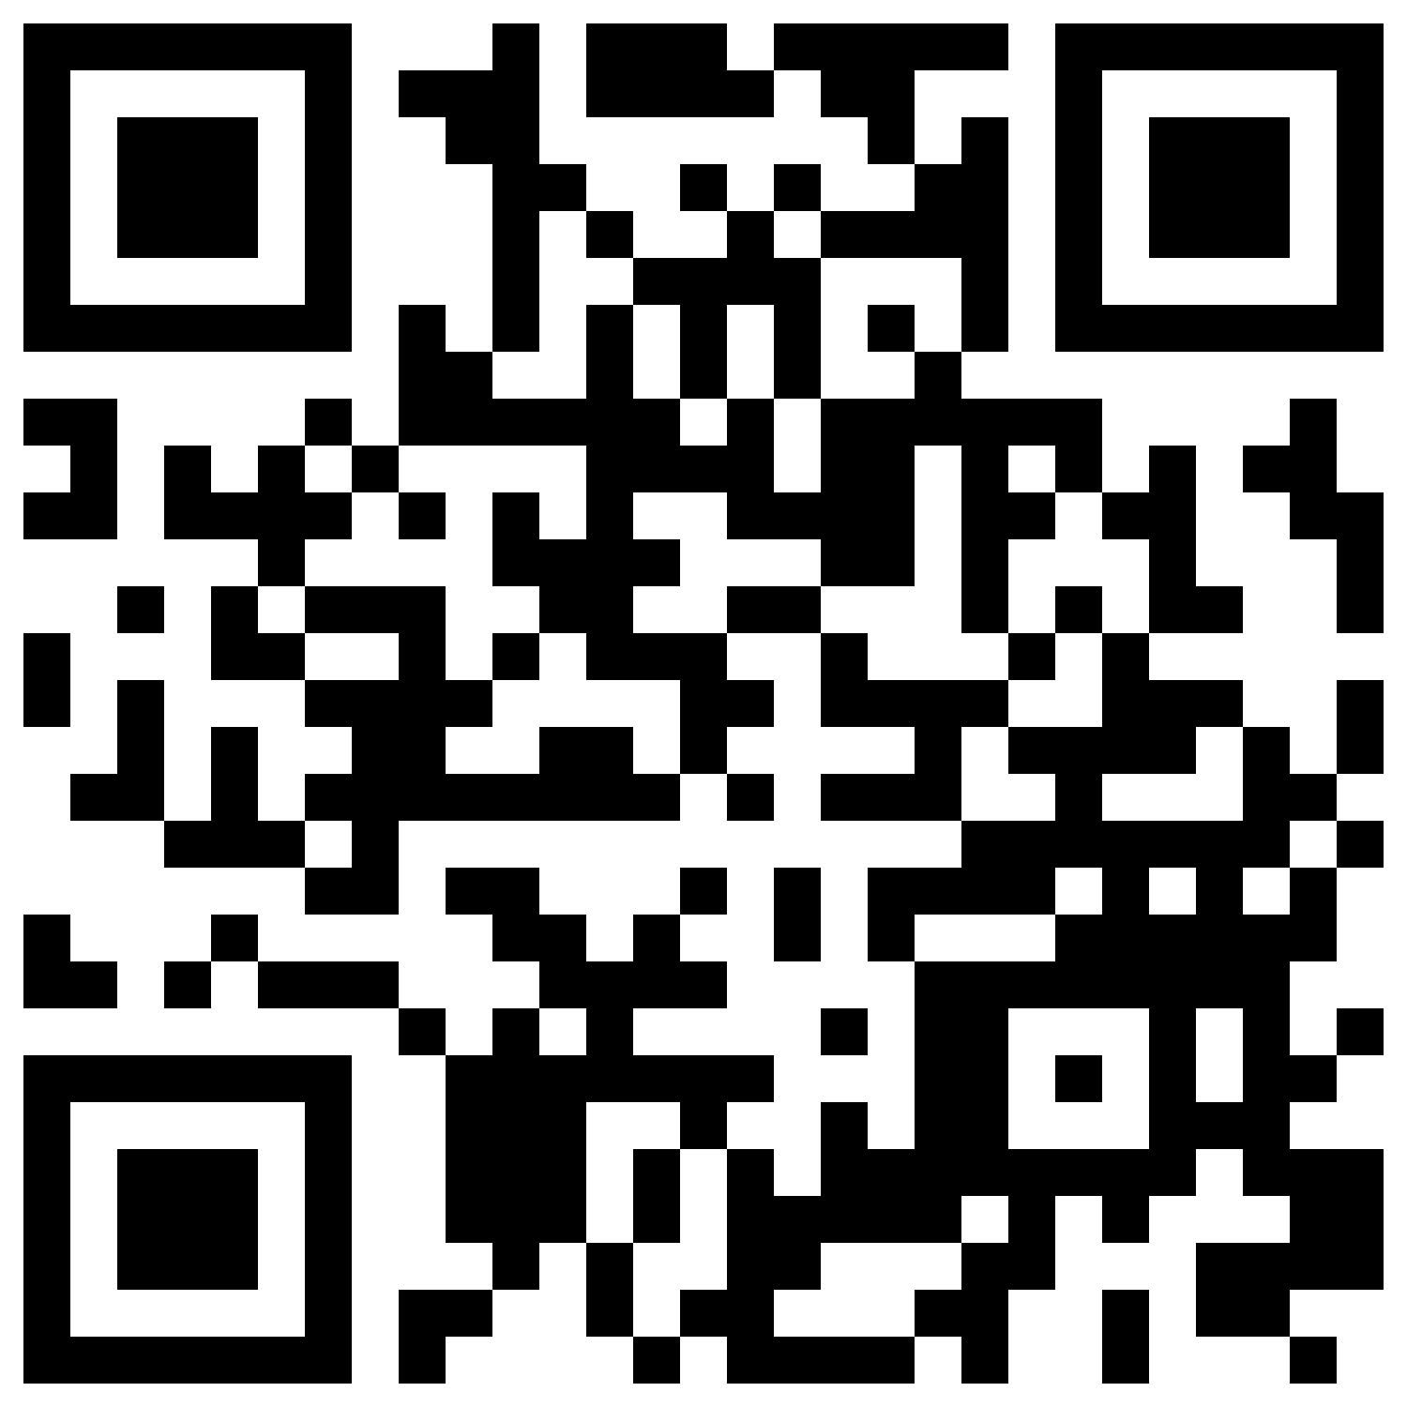
Breaking Bad: A Dataset for Geometric Fracture and Reassembly
Neural Information Processing Systems (NeurIPS) Track on Datasets and Benchmarks, 2022
Silvia Sellán
Yun-Chun Chen
Ziyi Wu
Animesh Garg
Alec Jacobson
Project Page (Data & Code):
https://breaking-bad-dataset.github.io/
Notes:
We present Breaking Bad, a dataset for geometric fracture and reassembly. This is joint work with Silvia, Yun-Chun, Ziyi, Animesh and Alec.

